Slide 1

A PROJECT ON DEVELOPING
VIDEO-CHATTING WEBSITE

Slide 2

Project members and project guide
PROJECT MEMBERS:
Rakshith T N
Janesh E S
PROJECT GUIDE:
Exposys Data Lab

Slide 3
CONTENTS
INTRODUCTION
OBJECTIVE
PROJECT OVERVIEW
DETAILS OF THE PROJECT
CONCLUSION

Slide 4
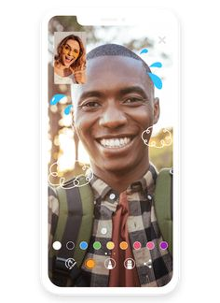
INTRODUCTION
JavaScript is high-level, often just-in-time compiled, and multi-paradigm. It has curly-bracket syntax, dynamic typing, prototype-based object-orientation.
This is a simple video-chatting application developed using HTML5, CSS3 & JavaScript.
It lets any two people around the globe to place a video call to each other. Although video chat mainly refers to point-to-point interaction.

Slide 5

Objective
Benefits
user friendly UI
Get connected to anyone & anywhere in the world
Our user's data is fully secured
Save your precious time
Talk to your loved once in a click

Slide 6
project overview
First
1
Through this App you can make Video calls and live chats at the same time.
Second
2
Just enter the username and get connected to anyone you need
Third
3
Make use of the app without any Ads and without sacrificing your personal data

Slide 7
details of the project
Topic : video-chatting website.
Languages Used : HTML,CSS,JAVASCRIPT.
Features :
Manage User
Manage chat
Template

Slide 8
conclusion
Video-chatting websites are best for business.
Nowadays video chatting became very essential for study and business purpose.
As more and more people were confined to their homes,this video chatting platform popularity rose exponentially.
Its the most effective and efficient ways for companies to communicate.
It saves companies a huge amount on travel costs , promotes face to face interactions.
Enhances collaboration by, making participants feel as though they are in the same room.

Slide 9
Thank You

